Slide 1
Basic Logic Gates
Discussion D5.1
Section 8.6.2
Sections 13-3, 13-4

Slide 2
Basic Logic Gates and Basic Digital Design
NOT, AND, and OR Gates
NAND and NOR Gates
DeMorgan’s Theorem
Exclusive-OR (XOR) Gate
Multiple-input Gates

Slide 3
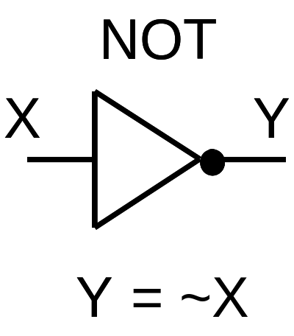
NOT Gate -- Inverter
X
Y
0
1
1
0

Slide 4
NOT
Y = ~X (Verilog)
Y = !X (ABEL)
Y = not X (VHDL)
Y = X’
Y = X
Y = X (textook)
not(Y,X) (Verilog)

Slide 5
NOT
X
~X
~~X = X
X ~X ~~X
0 1 0
1 0 1

Slide 6
AND Gate
AND
X Y Z
0 0 0
0 1 0
1 0 0
1 1 1
X
Z
Y
Z = X & Y

Slide 7
AND
X & Y (Verilog and ABEL)
X and Y (VHDL)
X Y
X Y
X * Y
XY (textbook)
and(Z,X,Y) (Verilog)
V
U

Slide 8
OR Gate
OR
X Y Z
0 0 0
0 1 1
1 0 1
1 1 1
X
Z
Y
Z = X | Y

Slide 9
OR
X | Y (Verilog)
X # Y (ABEL)
X or Y (VHDL)
X + Y (textbook)
X V Y
X U Y
or(Z,X,Y) (Verilog)

Slide 10
Basic Logic Gates and Basic Digital Design
NOT, AND, and OR Gates
NAND and NOR Gates
DeMorgan’s Theorem
Exclusive-OR (XOR) Gate
Multiple-input Gates

Slide 11
NAND Gate
NAND
X Y Z
0 0 1
0 1 1
1 0 1
1 1 0
X
Z
Y
Z = ~(X & Y)
nand(Z,X,Y)

Slide 12
NAND Gate
NOT-AND
X Y W Z
0 0 0 1
0 1 0 1
1 0 0 1
1 1 1 0
X
W
Z
Y
W = X & Y
Z = ~W = ~(X & Y)

Slide 13
NOR Gate
NOR
X Y Z
0 0 1
0 1 0
1 0 0
1 1 0
X
Z
Y
Z = ~(X | Y)
nor(Z,X,Y)

Slide 14
NOR Gate
NOT-OR
X Y W Z
0 0 0 1
0 1 1 0
1 0 1 0
1 1 1 0
X
W
Z
Y
W = X | Y
Z = ~W = ~(X | Y)

Slide 15
Basic Logic Gates and Basic Digital Design
NOT, AND, and OR Gates
NAND and NOR Gates
DeMorgan’s Theorem
Exclusive-OR (XOR) Gate
Multiple-input Gates

Slide 16
NAND Gate
X
Z
X
Z
=
Y
Y
Z = ~(X & Y)
Z = ~X | ~Y
X Y W Z
0 0 0 1
0 1 0 1
1 0 0 1
1 1 1 0
X Y ~X ~Y Z
0 0 1 1 1
0 1 1 0 1
1 0 0 1 1
1 1 0 0 0

Slide 17
De Morgan’s Theorem-1
~(X & Y) = ~X | ~Y
NOT all variables
Change & to | and | to &
NOT the result

Slide 18
NOR Gate
X
X
Z
Z
Y
Y
Z = ~(X | Y)
Z = ~X & ~Y
X Y Z
0 0 1
0 1 0
1 0 0
1 1 0
X Y ~X ~Y Z
0 0 1 1 1
0 1 1 0 0
1 0 0 1 0
1 1 0 0 0

Slide 19
De Morgan’s Theorem-2
~(X | Y) = ~X & ~Y
NOT all variables
Change & to | and | to &
NOT the result

Slide 20
De Morgan’s Theorem
NOT all variables
Change & to | and | to &
NOT the result
--------------------------------------------
~X | ~Y = ~(~~X & ~~Y) = ~(X & Y)
~(X & Y) = ~~(~X | ~Y) = ~X | ~Y
~X & !Y = ~(~~X | ~~Y) = ~(X | Y)
~(X | Y) = ~~(~X & ~Y) = ~X & ~Y

Slide 21
Basic Logic Gates and Basic Digital Design
NOT, AND, and OR Gates
NAND and NOR Gates
DeMorgan’s Theorem
Exclusive-OR (XOR) Gate
Multiple-input Gates

Slide 22
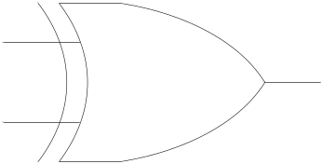
Exclusive-OR Gate
XOR
X Y Z
X
Z
0 0 0
Y
0 1 1
Z = X ^ Y
xor(Z,X,Y)
1 0 1
1 1 0

Slide 23
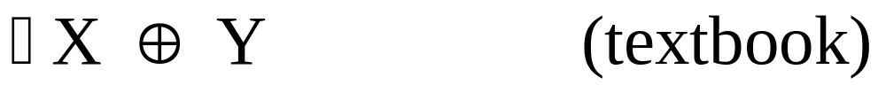
XOR
X ^ Y (Verilog)
X $ Y (ABEL)
X @ Y
xor(Z,X,Y) (Verilog)

Slide 24
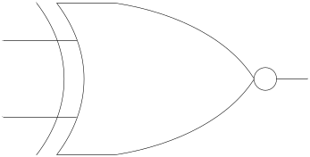
Exclusive-NOR Gate
XNOR
X Y Z
X
Z
0 0 1
Y
0 1 0
Z = ~(X ^ Y)
Z = X ~^ Y
xnor(Z,X,Y)
1 0 0
1 1 1

Slide 25
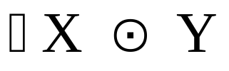
XNOR
X ~^ Y (Verilog)
!(X $ Y) (ABEL)
X @ Y
xnor(Z,X,Y) (Verilog)

Slide 26
Basic Logic Gates and Basic Digital Design
NOT, AND, and OR Gates
NAND and NOR Gates
DeMorgan’s Theorem
Exclusive-OR (XOR) Gate
Multiple-input Gates

Slide 27
Multiple-input Gates
Z
1
Z
2
Z
Z
4
3

Slide 28
Multiple-input AND Gate
Z
1
Output is HIGH only if all inputs are HIGH
Z
1
An open input will float HIGH

Slide 29
Multiple-input OR Gate
Z
2
Output is LOW only if all inputs are LOW
Z
2

Slide 30
Multiple-input NAND Gate
Z
3
Output is LOW only if all inputs are HIGH
Z
3

Slide 31
Multiple-input NOR Gate
Z
4
Output is HIGH only if all inputs are LOW
Z
4

